Slide 1

SAATHI
Because there is no health without mental health
A mental health and well-being surveillance, assessment and tracking solution among students.
Ashutosh Verma
Ananya Verma
Arpita

Slide 2


Slide 3
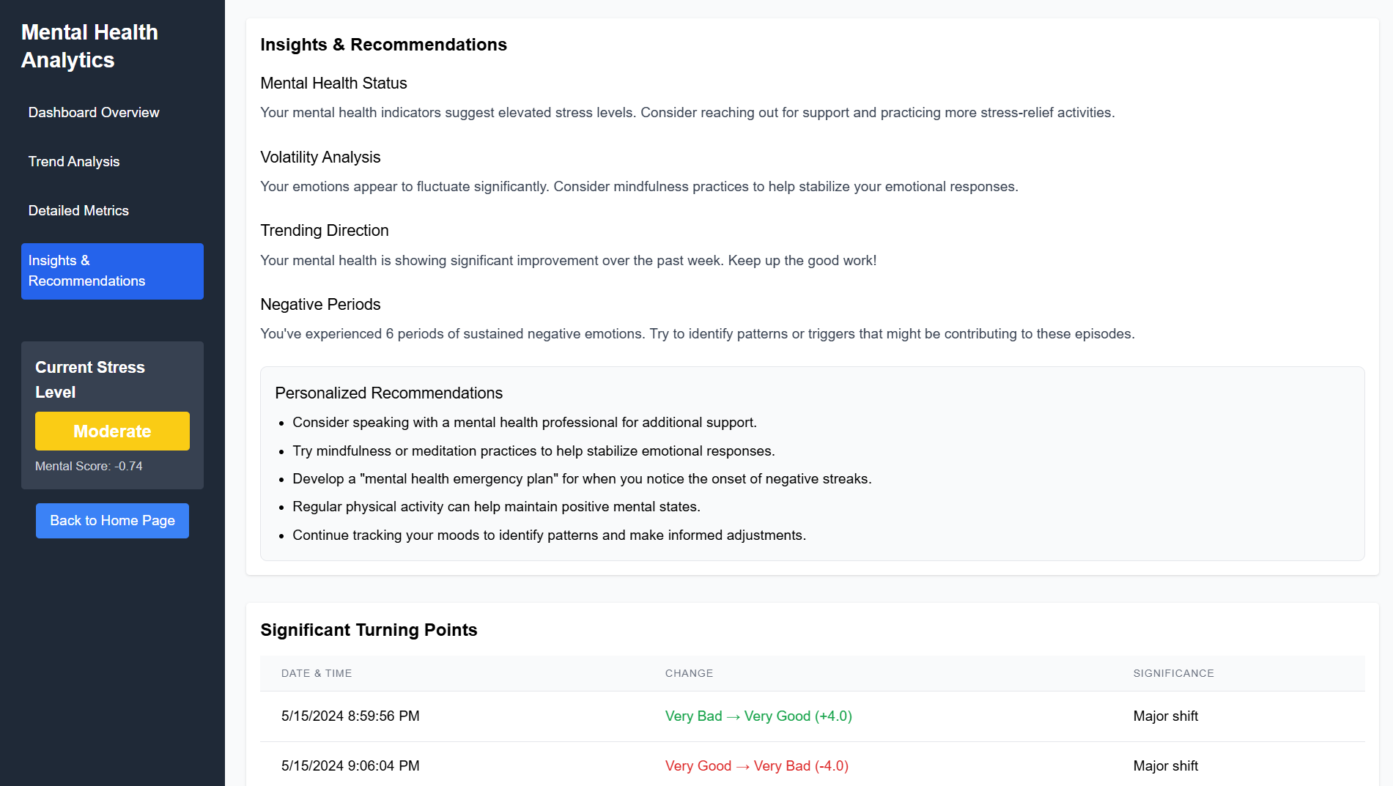

Slide 4
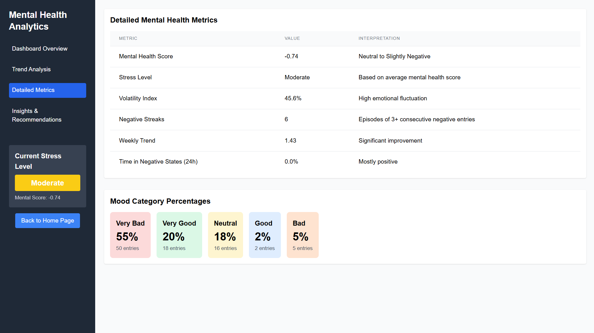

Slide 5
Project Abstract
Overview
Key Objectives
Approach
This project aims is to offer a safe, supportive, and engaging environment for students dealing with mental health issues, using a human-like chatbot. This system ensures early intervention and
secure and natural interactions, providing comfort and guidance to students ,thereby improving mental health outcomes.
A secure and human-like chatbot to interact effectively with students.
Improve model accuracy to ensure meaningful, empathetic, and context-aware responses.
Expand the dataset to include diverse mental health scenarios for broader coverage and improved intervention.
Initial focus was placed on natural language processing (NLP) techniques to ensure Human-like chatbot Interactions with Students suffering from any mental health issue and focused on Noble improvements in model accuracy and dataset expansion for effective early mental health intervention.

Slide 6

Project Goals and Objectives
Achieve Secure and Human-like Chatbot
Interactions
1
capable of delivering empathetic, human-like responses to students experiencing mental health challenges while ensuring robust data privacy and security to maintain user trust and confidentiality.
2
Provide Accessible Mental Health Support:
Create a safe and supportive AI-powered platform where students can discuss their mental health concerns without fear of judgment.
Promote Positive Behavioral Change:
3
Use Cognitive Behavioral Therapy (CBT) and Behavioral Activation (BA) techniques to help students replace negative thought patterns and adopt constructive actions to improve emotional health..

Slide 7
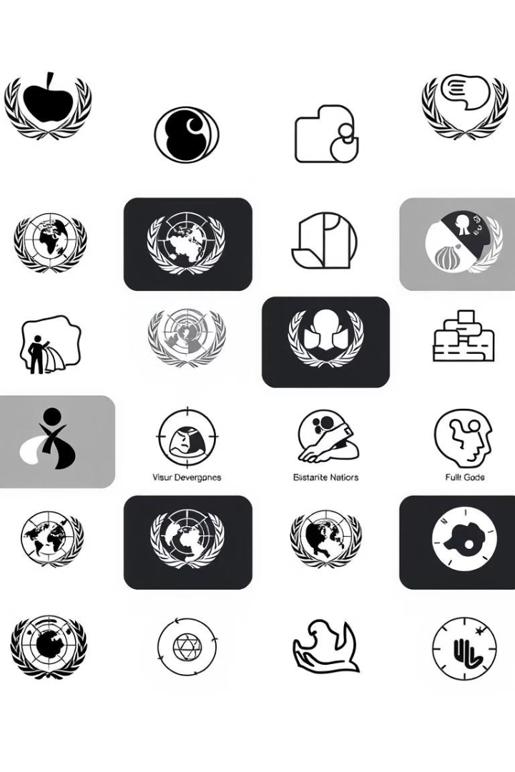
Alignment with UN Sustainable Development Goals (SDGs)
SDG 3: Good Health and Well-being, with potential secondary contributions
SDG 4: Quality Education
SDG 10: Reduced Inequality.

Slide 8





Methodology and Approach
Cognitive Behavioral Therapy (CBT) Integration
Utilize CBT techniques to help users identify and replace negative thought patterns with realistic, constructive alternatives, supporting improved emotional well-being.
Behavioral Activation (BA)
Recommend positive actions and behaviors that actively influence and enhance users' emotional states, helping to reduce stress and anxiety.
Transformer-based NLP with BERT
Deploy BERT, a powerful transformer-based language model, to process user inputs, detect emotional nuances, and generate empathetic, context-aware responses.
Mood Scoring System
Assign mental health scores (1–5) based on sentiment analysis, categorizing emotional states into five levels—ranging from "Very Bad" to "Very Good"—to monitor well-being and provide tailored support.

Slide 9




.
Expected Outcomes and Impact
Intreactive model
Early detection and intervention
Community Empowerment
Secure human like interactions with students suffering from mental health issues
Identifies emotional distress for the proactive interventions
Engaging powerful , healthier thoughts and pattern among the students.

Slide 10

Key Project Deliverables
AI-Powered Chatbot System Utilizing CBT and BA techniques , Providing
personalized mental health support
Mood Detection and Scoring
Framework:
Categorize user emotions ,assign mental health scores , continuous monitoring.
Comprehensive Mental Health
Reports:
Tracking progress ,providing behavioral recommendations

Slide 11

Next Steps and Conclusion
1
Scale and Expand
2
Forge Partnerships
Explores automation of mental health detection using Cognitive Behavioral Therapy.
Collaborate with government, private sector, and civil society to further strengthen the initiative.
3
Monitor and Evaluate
Continuously assess the project's performance and make adjustments to optimize its effectiveness.

